Slide 1

Lab 3: Your First Hack: Part 2
Ryan Coon
CYB-610
Professor Ian Standefer
April 9, 2025

Slide 2
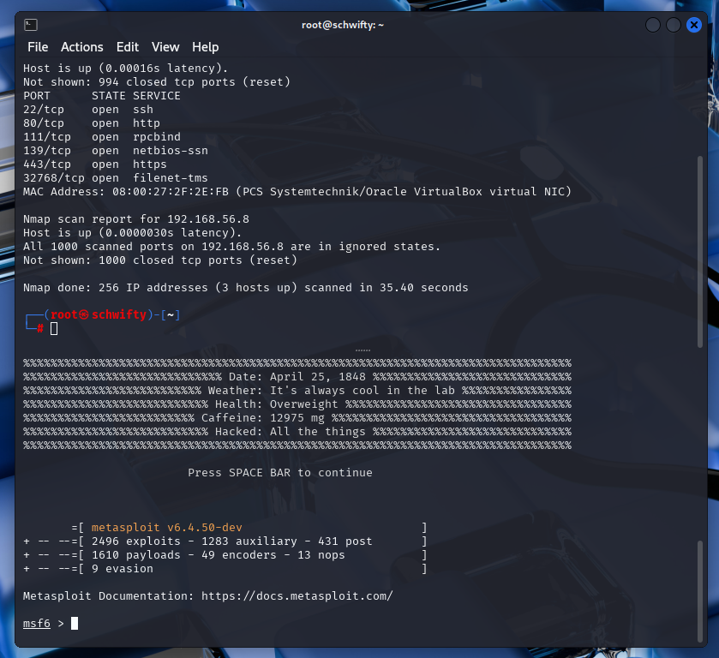
Notes:
Run nmap and open metasploit

Slide 3
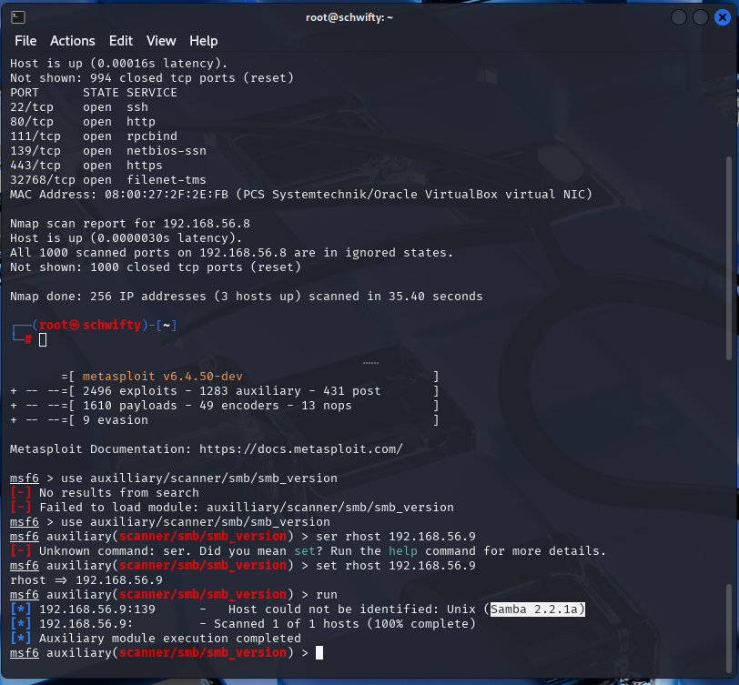
Notes:
Set Metasploit to scan samba version. See that it is samba 2.2.1a

Slide 4
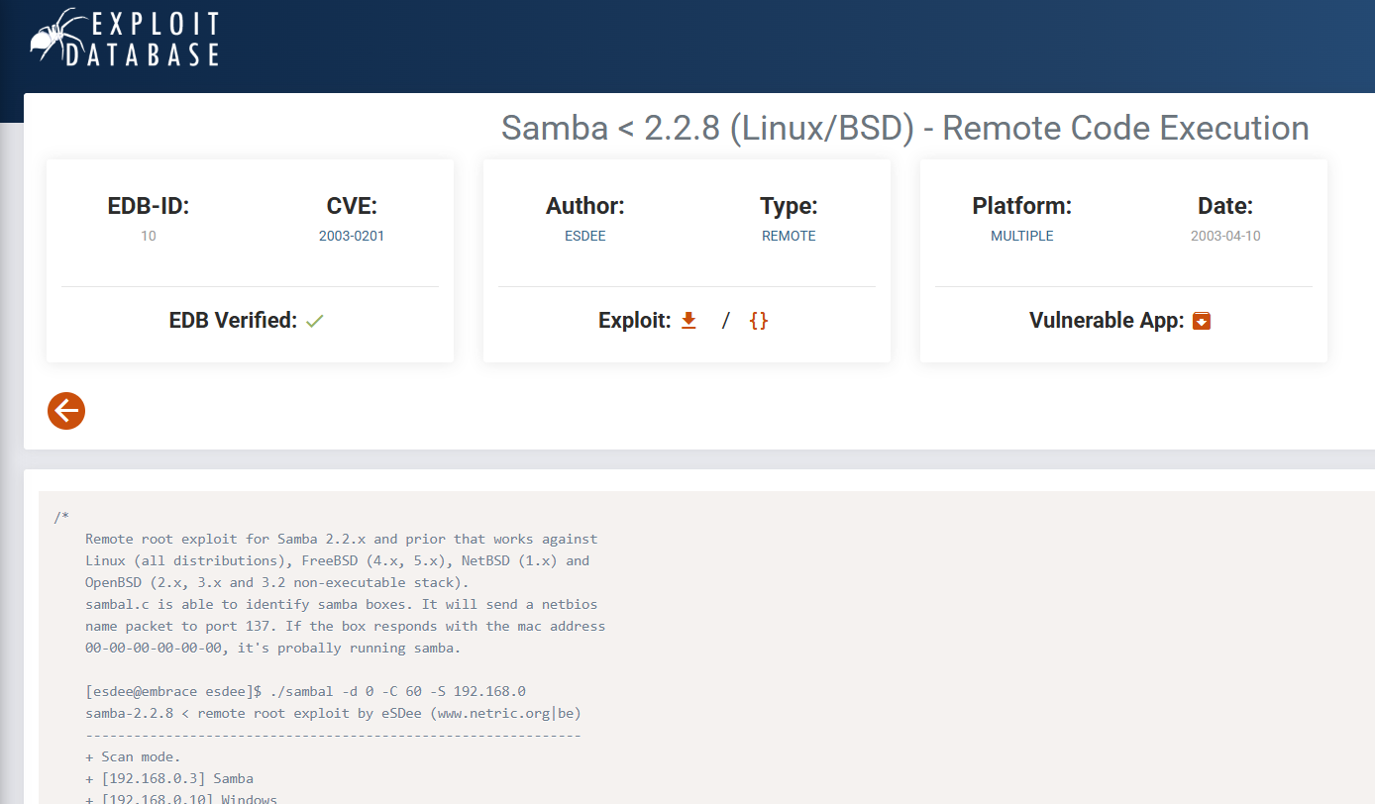
Notes:
Searched samba 2.2.1a and open exploit database. Copy code

Slide 5
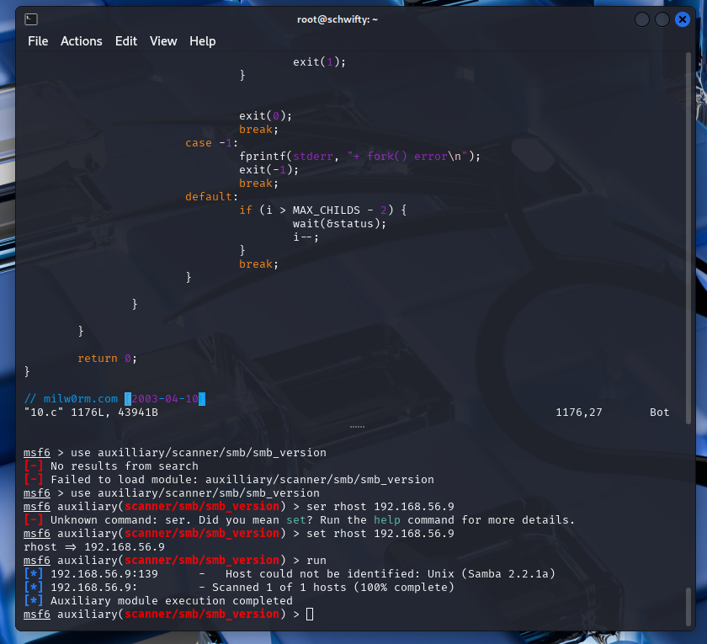
Notes:
Open a new file and paste code into the file. Compile and set as 10

Slide 6
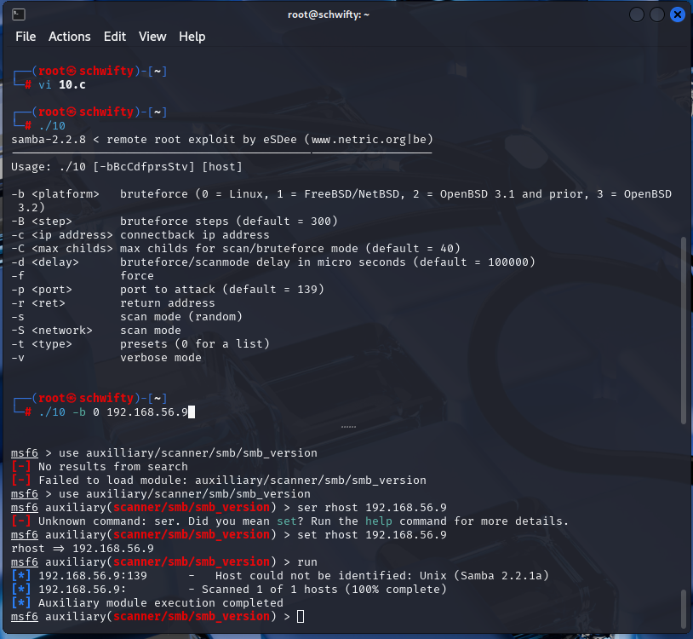
Notes:
Run the 10 command against the kioptrix ip

Slide 7
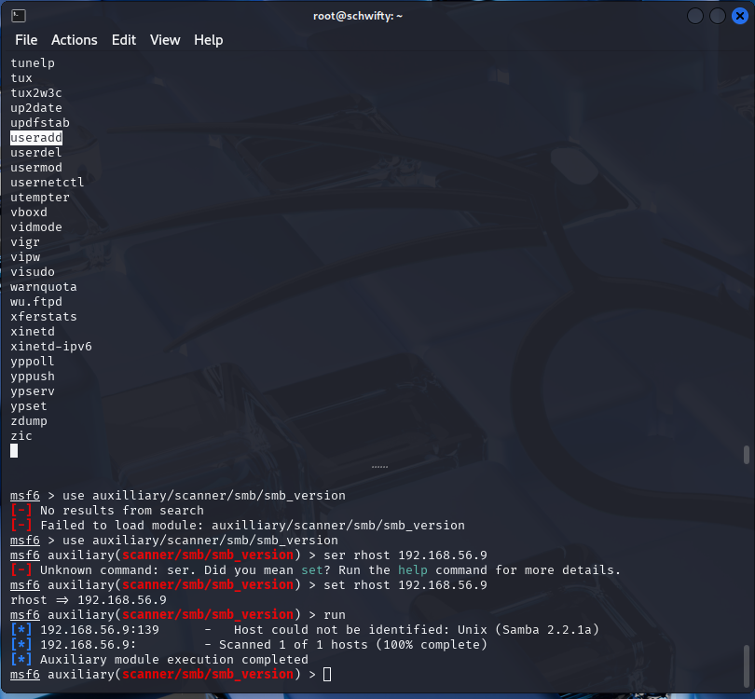
Notes:
Search through the kioptrix file system untul you find Cd usr cd sbin you find useradd

Slide 8
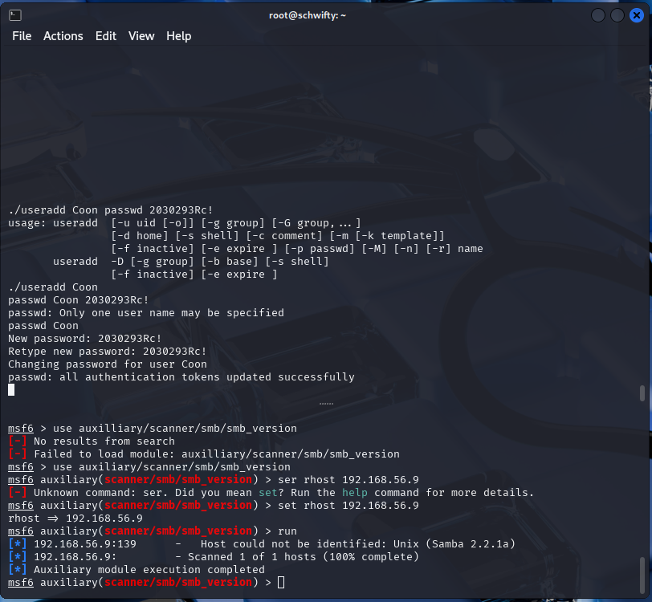
Notes:
Add a new user along with password

Slide 9
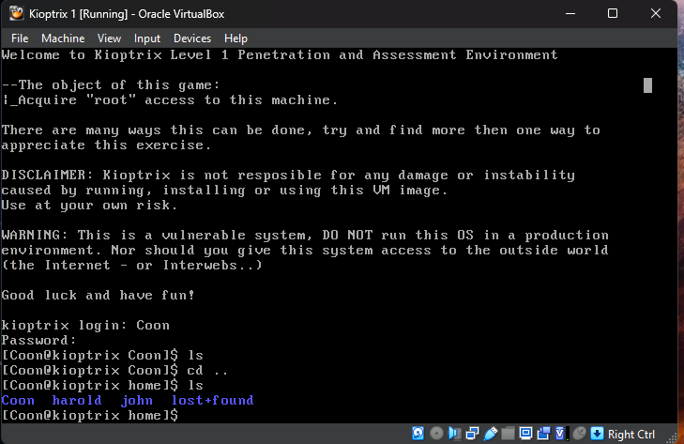
Notes:
Log in on kioptrix and show that we are root

Slide 10
Without the option of upgrading or replacing the system, we need to focus on mitigating vulnerabilities through defense-in-depth strategies. This involves layering multiple security controls to make it harder for attackers to exploit any single weakness.

Slide 11


Hardening - Implement strong security configurations for the operating system and applications. This includes disabling unnecessary services, using strong passwords, and applying security updates regularly.
Least Privilege - Grant users only the minimum permissions they need to perform their tasks. This limits the damage an attacker can do if they gain access to a user account.
Input Validation - Thoroughly validate all user inputs to prevent malicious data from being injected into the system. This can help prevent attacks like SQL injection and cross-site scripting.
Network Segmentation - Isolate sensitive systems and data from public networks. This can reduce the attack surface and limit the spread of malware.
Intrusion Detection and Prevention Systems (IDS/IPS) - Deploy intrusion detection and prevention systems to monitor network traffic for suspicious activity and block known attacks.

Slide 12

Buffer Overflow
Definition - A buffer overflow occurs when a program writes more data into a buffer than it can hold, potentially overwriting adjacent memory locations. This can lead to code execution or denial-of-service attacks.
Summary - Attackers can exploit buffer overflows to inject malicious code into the system's memory and gain control.
Categorization - Exploitation of memory management vulnerabilities.

Slide 13

Privilege Escalation
Definition - Privilege escalation is the act of gaining elevated privileges on a system, often by exploiting vulnerabilities in the operating system or applications.
Summary - Attackers use privilege escalation to gain more control over the system, potentially allowing them to access sensitive data or modify system settings.
Categorization - Exploitation of access control vulnerabilities.

Slide 14

Rootkits
Definition - A rootkit is a set of tools that allow attackers to hide their presence on a system and maintain persistent access.
Summary - Rootkits can conceal malicious activity, making it difficult to detect and remove.
Categorization - Malware designed for stealth and persistence.

Slide 15

Trojans
Definition - A Trojan horse is a program that appears legitimate but contains malicious code that can harm the system.
Summary - Trojans can steal data, install other malware, or grant attackers remote access to the system.
Categorization - Malware disguised as legitimate software.

Slide 16

Backdoors
Definition - A backdoor is a hidden mechanism that allows attackers to bypass security measures and gain access to a system.
Summary - Backdoors can be intentionally built into software or installed by attackers to gain persistent access.
Categorization - Hidden access points for unauthorized entry.

Slide 17

Viruses
Definition - A virus is a self-replicating program that can spread from one system to another.
Summary - Viruses can corrupt data, damage files, or steal information.
Categorization - Malware that replicates itself and spreads through networks.

Slide 18

Return-Oriented Programming (ROP)
Definition - ROP is a technique used by attackers to execute malicious code by chaining together existing code snippets (gadgets) within a program.
Summary - ROP allows attackers to bypass security measures and gain control of the system even if their own code cannot be directly executed.
Categorization - Advanced exploitation technique that uses existing code to achieve malicious goals.

Slide 19

Common Social Engineering Attacks
Definition - Social engineering attacks exploit human psychology to trick victims into revealing sensitive information or granting unauthorized access.
Summary - Attackers use various tactics, such as phishing emails, pretexting, and baiting, to manipulate victims into performing actions that compromise security.
Categorization - Attacks that rely on human error and manipulation.

Slide 20
Thank You

